Slide 1

Laptop Market Data Analysis
Data Storytelling & Statistical Validation:
A complete business intelligence and analytical study performed on laptop market data using Python, EDA, Statistical Testing, and Power BI Dashboarding.

Slide 2
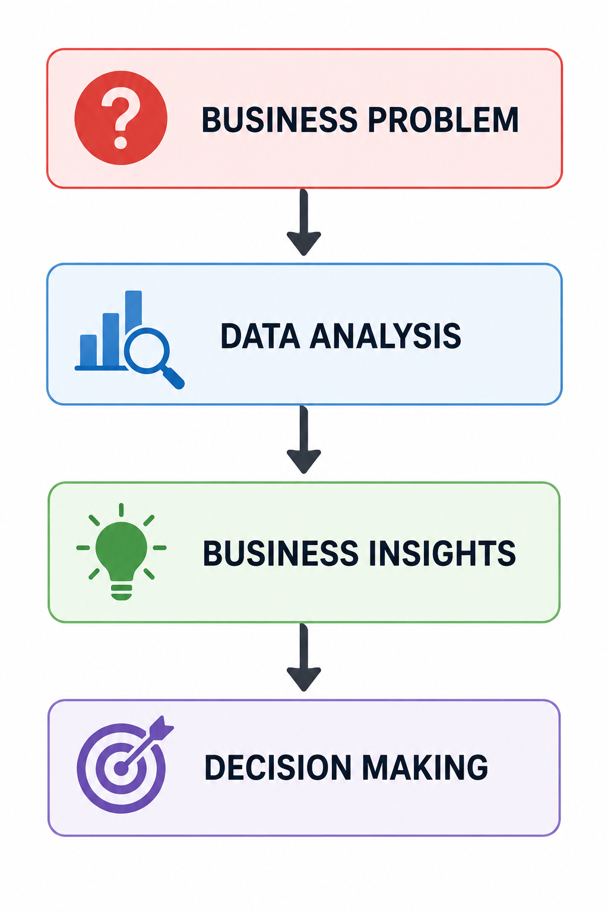
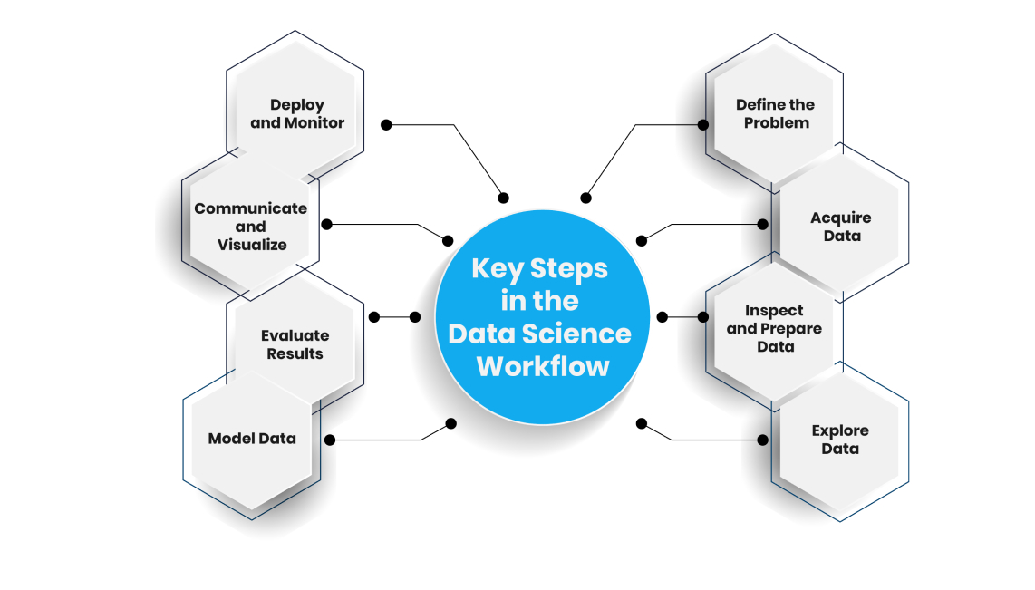
Objective:
The objective of this project is to analyze laptop market data to identify pricing patterns, brand trends, customer preferences, and important business insights. The project also focuses on statistical validation and dashboard-driven decision-making.

Slide 3
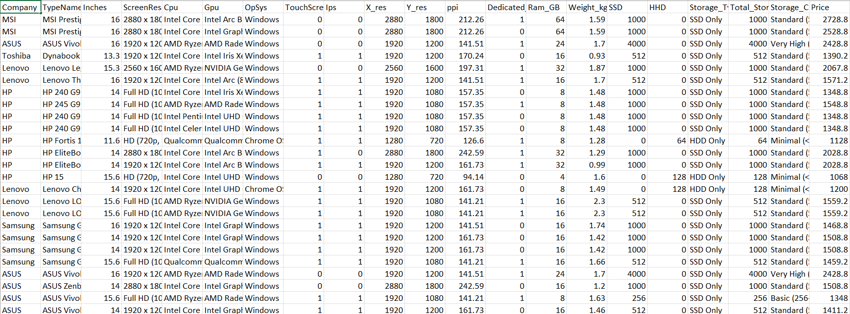
Dataset Overview:
The dataset contains information related to laptop brands,
pricing, RAM, storage, processors, and product categories.
The dataset was used to uncover trends and perform
business intelligence analysis.

Slide 4
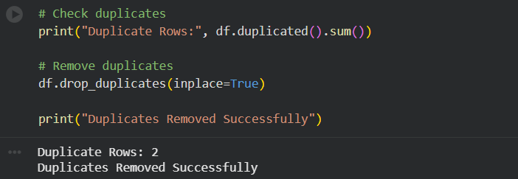

Data Cleaning and Wrangling:
The dataset was cleaned to improve data quality
and analytical accuracy.
Missing values, duplicates, and inconsistent formats
were handled using Python and Pandas.

Slide 5
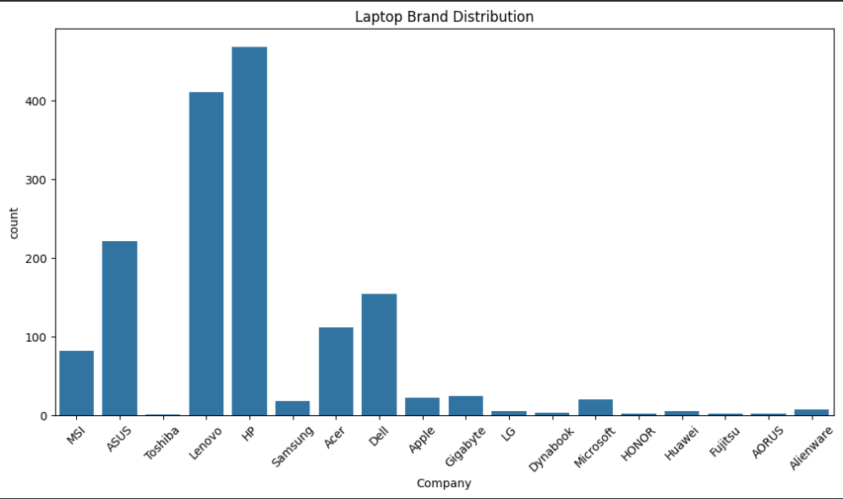
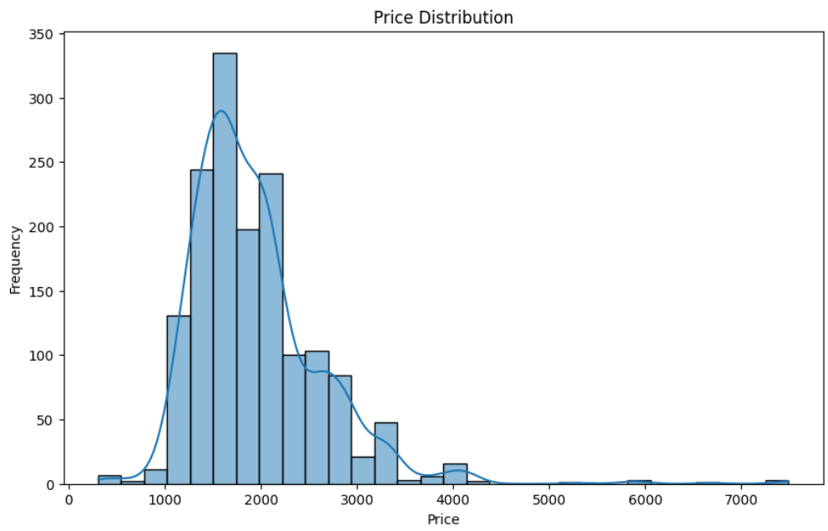
Exploratory Data Analysis(EDA):
EDA was performed to identify patterns, distributions,
and relationships within the dataset.
Several visualizations were created using Matplotlib
and Seaborn.

Slide 6

Business Insights:
The analysis revealed several valuable business insights
related to pricing, customer preferences, and market trends.
• Dell and HP dominate the market
• Gaming laptops have higher prices
• SSD storage is common in premium laptops
• Higher RAM increases laptop prices
• Intel processors are most frequently used

Slide 7

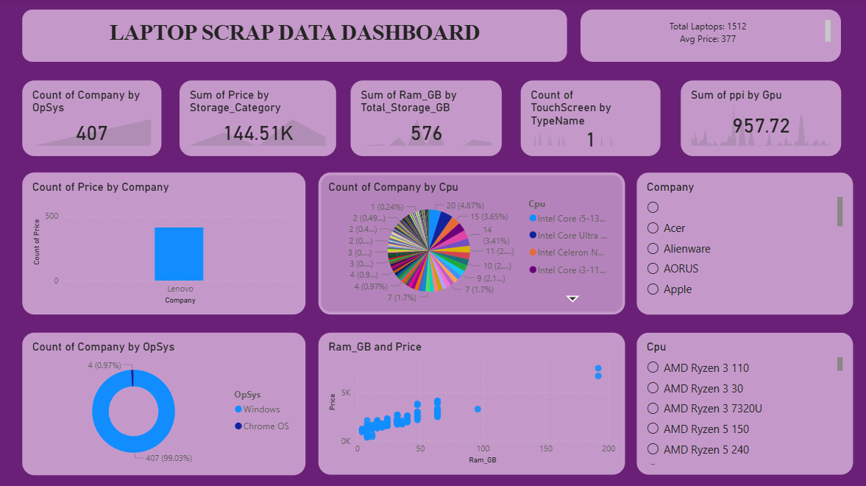
Dashboard Overview:
An interactive dashboard was created using Power BI
to monitor KPIs and business metrics effectively.

Slide 8
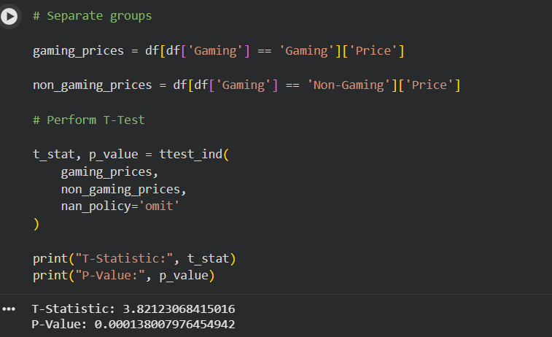
Hypothesis Testing:
Hypothesis testing was performed to statistically validate
whether gaming laptops are significantly more expensive
than non-gaming laptops.
Includes:
Null Hypothesis: Gaming and non-gaming laptops have equal average prices.
Alternative Hypothesis:Gaming laptops have significantly higher prices.

Slide 9

Conclusion:
The project successfully identified important business
trends and pricing patterns in the laptop market.
Statistical testing validated that gaming laptops
have significantly higher pricing.
• SSD laptops dominate premium segment
• Gaming laptops generate higher revenue
• RAM strongly impacts pricing
• Dashboarding improves decision-making

Slide 10
THANK YOU

